Slide 1
INSTITUTE FOR ADVANCED
COMPUTING AND
SOFTWARE DEVELOPMENT
AKURDI, PUNE
Project Title
“THINGS TO DONATE”
E-DAC SEP- 2020
Presented By
Group No.64
Pooja Patil:2121
Geetashri Belle:2049
Project Guide
Mr. Milind Arjun

Slide 2
INTRODUCTION
This document communicates the business requirements and scope for developing online donation platform system named as “Things to donate”. The scope of this document is to define the functional and non-functional requirements, business rules and other constraints requirements.

Slide 3
Features Of System
There Are Three Modules in Project
1.Admin
2.Donor
3.Receiver
Admin:
1.Admin can login to the system.
2.View receiver
3.Reject receiver request.
4.Add social Work.
5.View Social workers

Slide 4
Donor:
Donor can login to the system.
View his/her details.
The donor is the user of the system who wants to donate the product.
He is also able to view the Categories of products to Donate.

Slide 5
Receiver Module:
Receiver is one who will receive the donated product.
Receiver can be NGO’s or Social Serving entities.
Receiver is able to view the Categories of products, select & freeze the product.
Receiver can send requirement for product of their need.

Slide 6
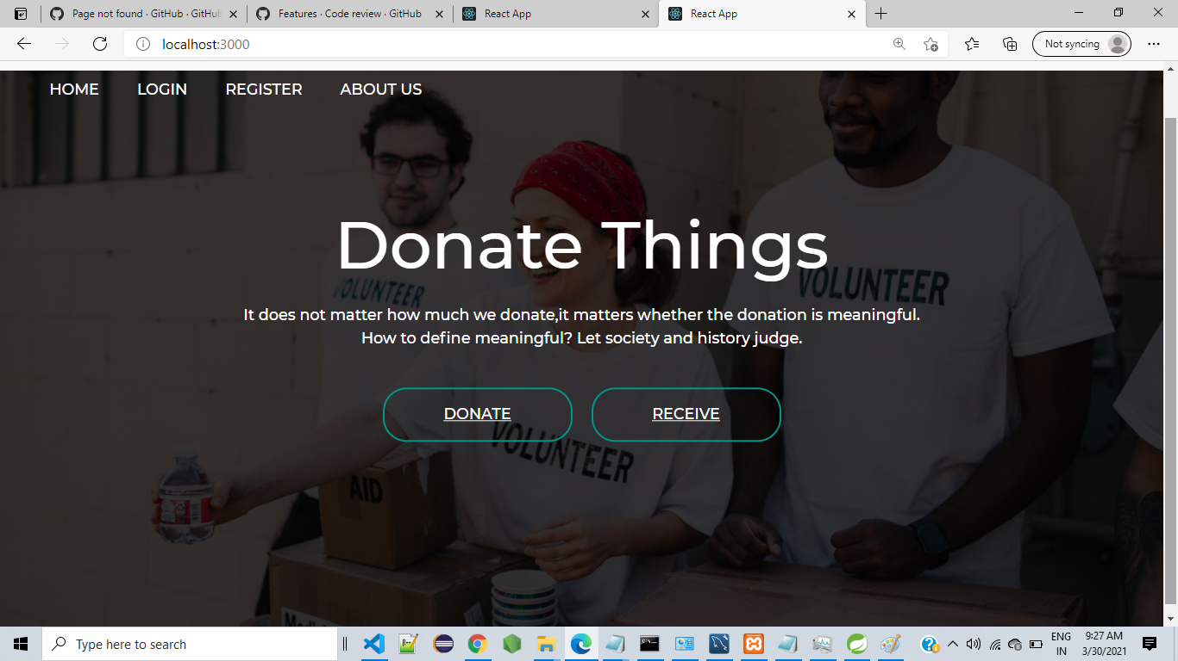
1.Home Page

Slide 7
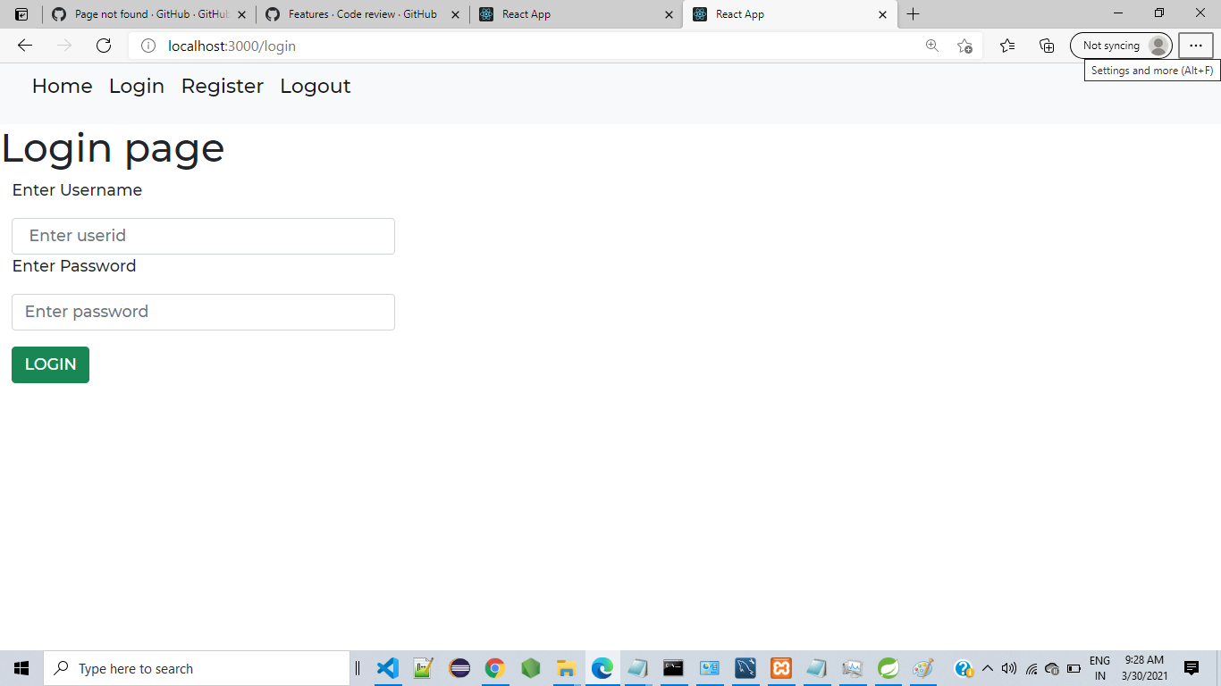
Login Page

Slide 8
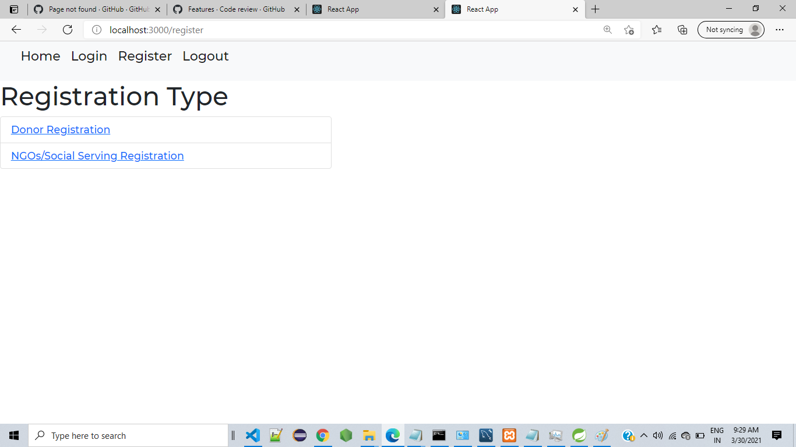
Registration page

Slide 9
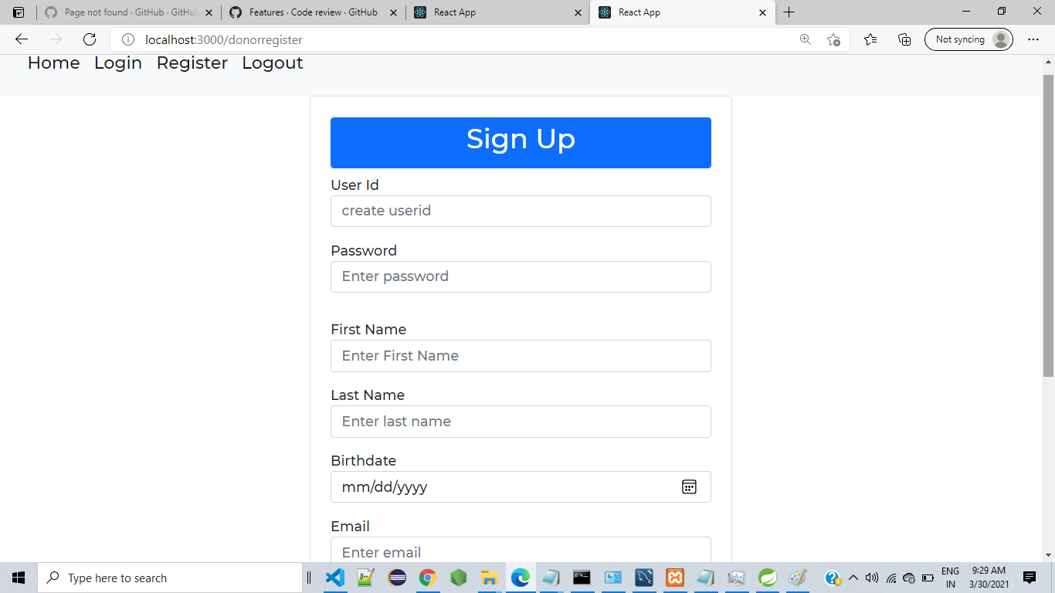
Donor Registration

Slide 10
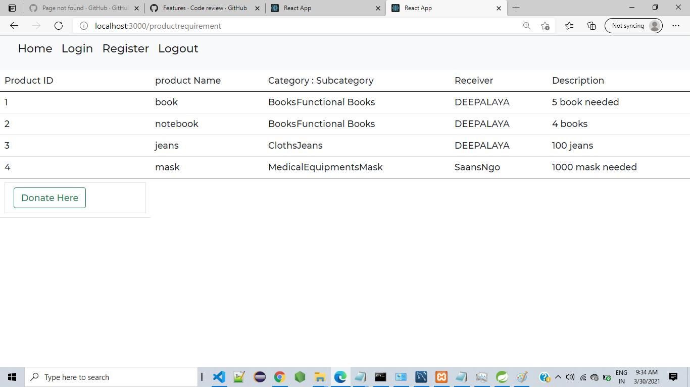
Donor Side Product Req. List

Slide 11
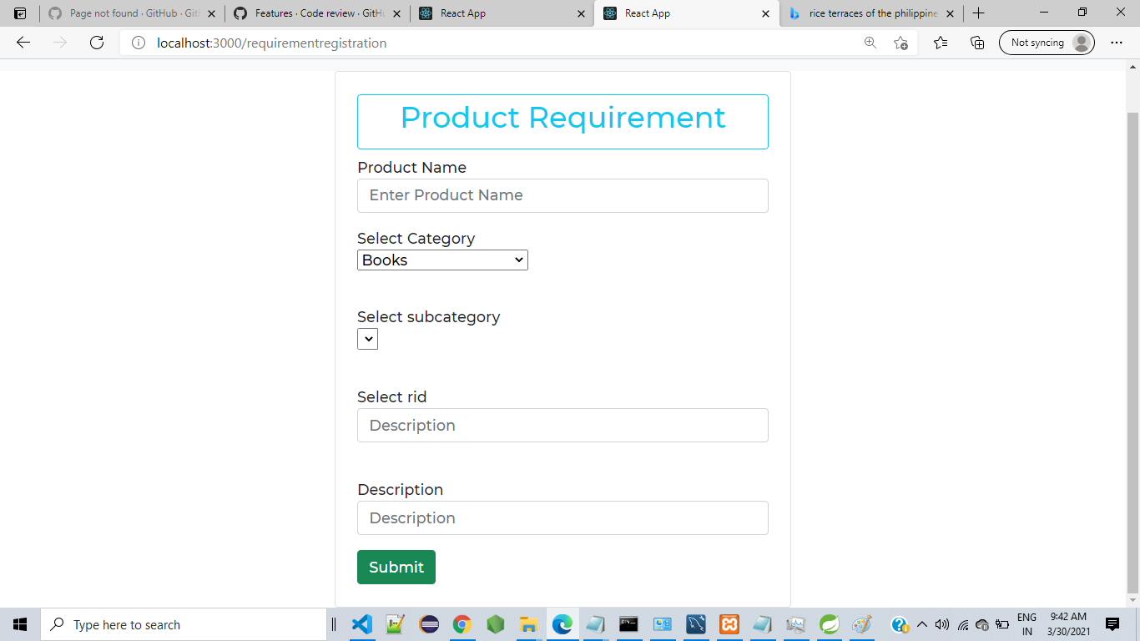
Product Requirement

Slide 12
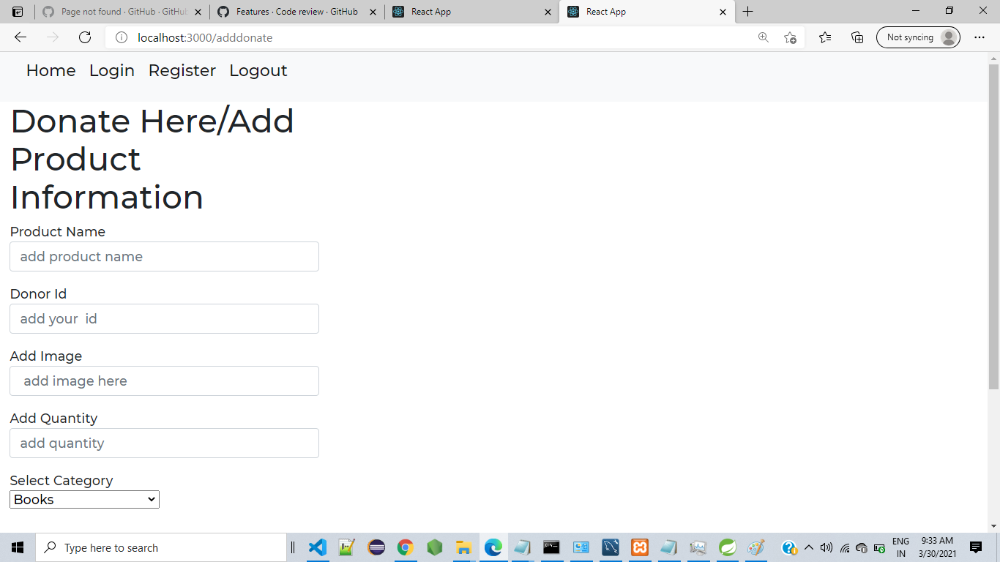
Donated Product form

Slide 13
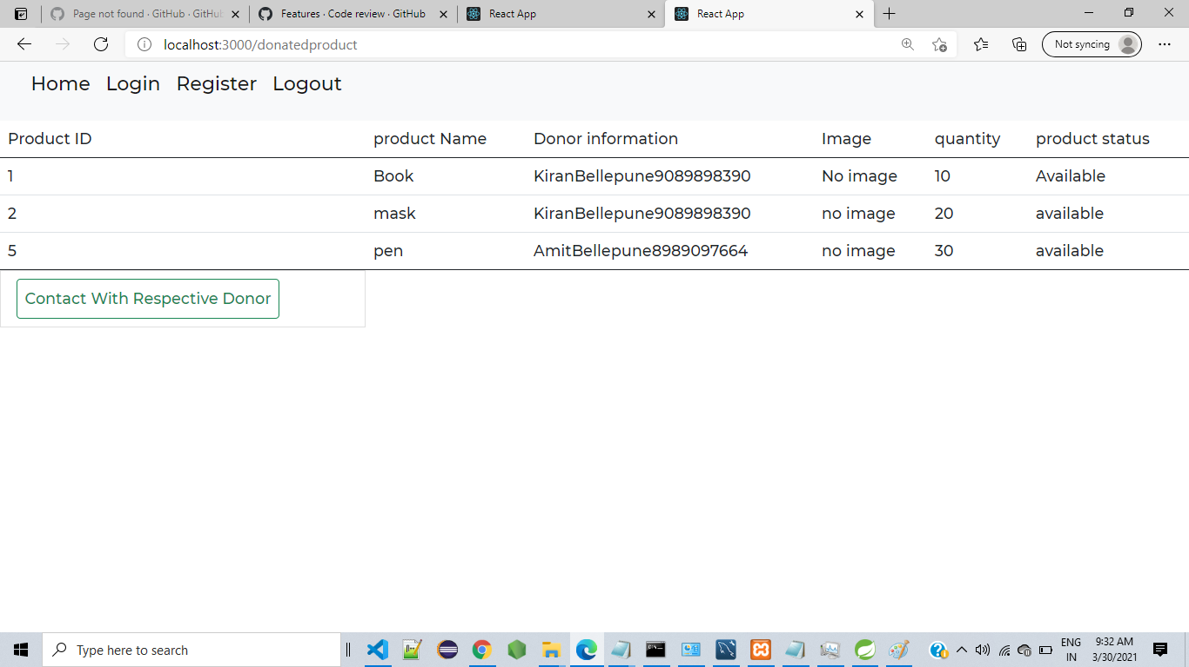
Donated Item List

Slide 14
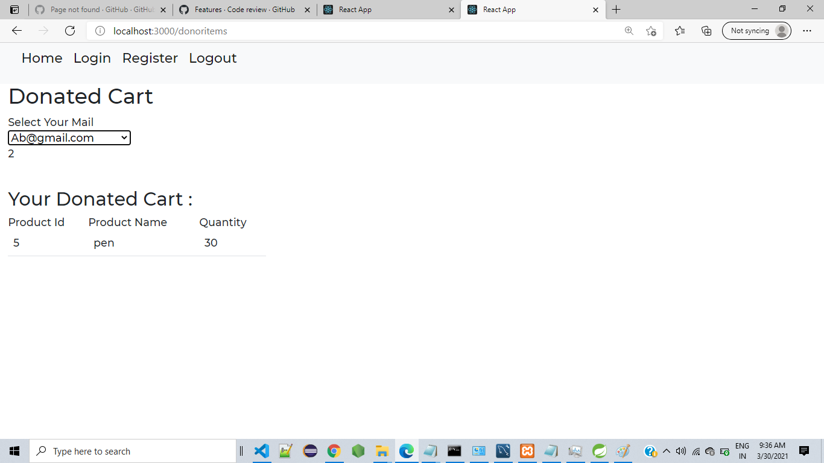
Donated Cart Item

Slide 15
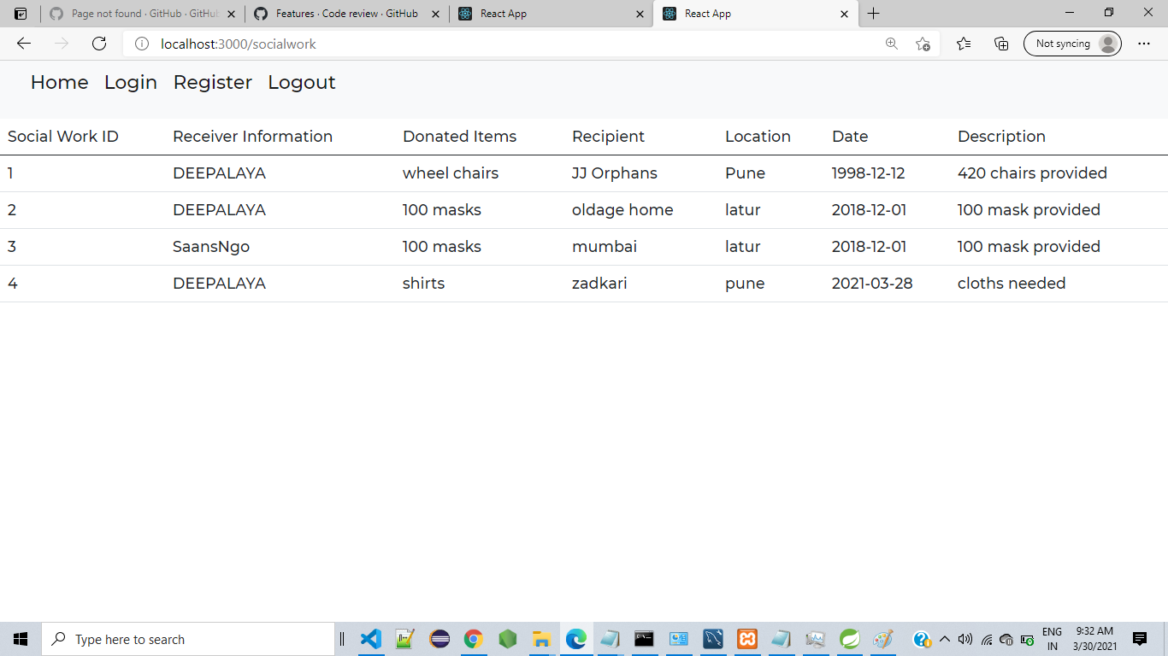
Social Deeds

Slide 16
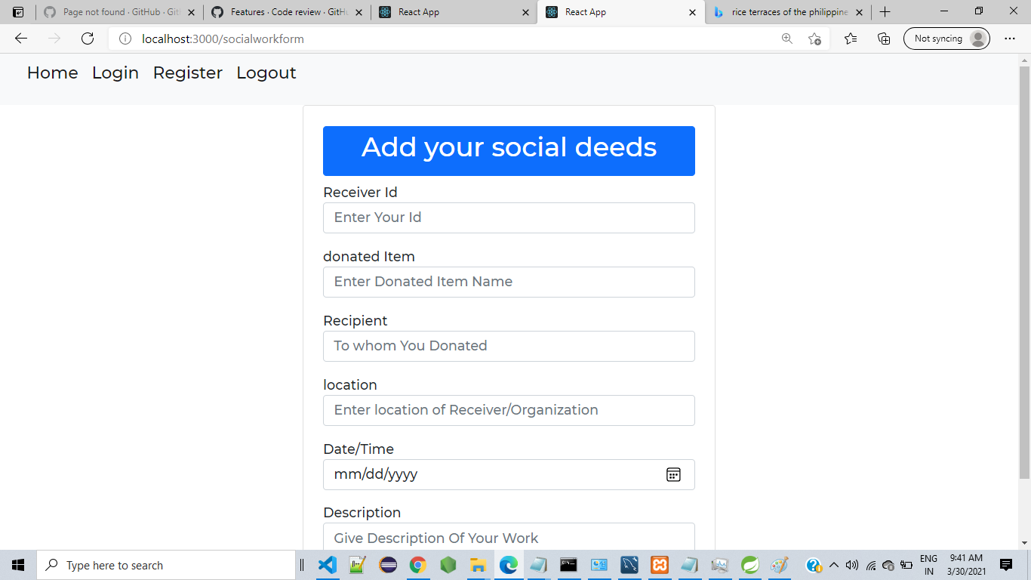
Add social Deeds

Slide 17

Donor side Soial deeds

Slide 18
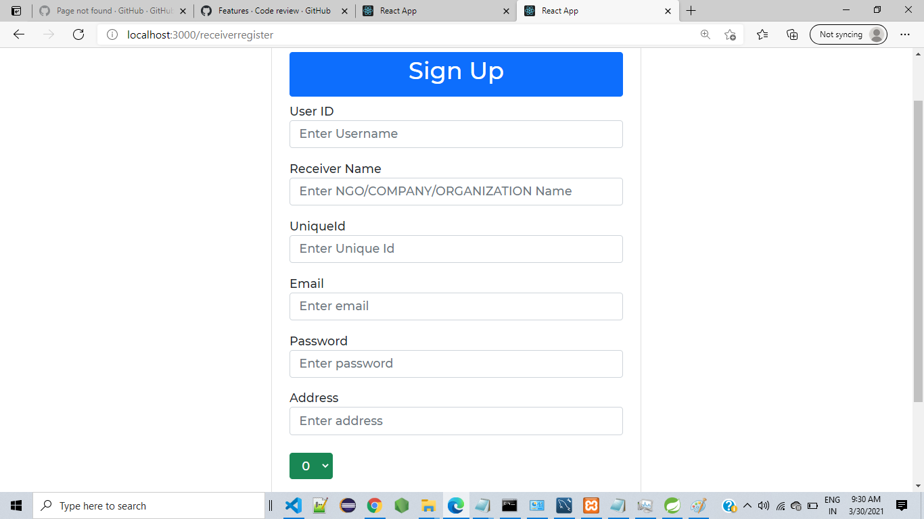
Receiver Reg.

Slide 19
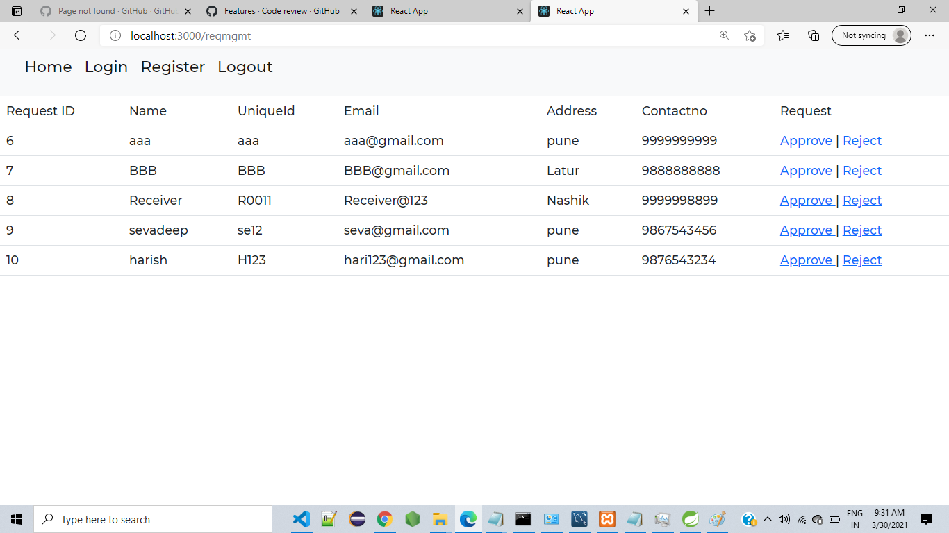
Req. Reg.

Slide 20
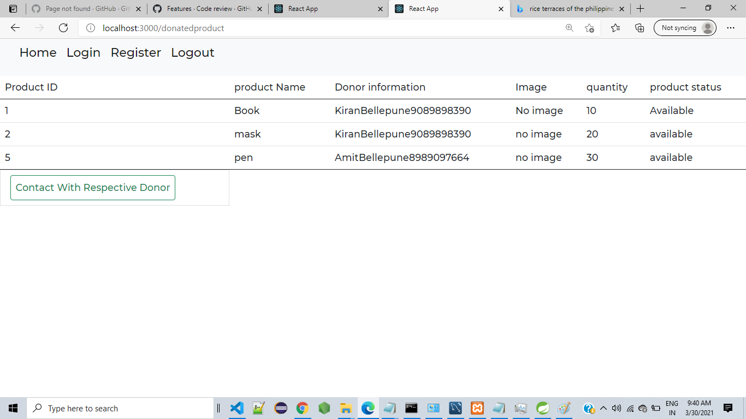
Receiver Side Donor List

Slide 21
Conclusion
Online donation platform puts forth the helping hands for social deeds. Donor can Donate services and functionalities from the society anywhere and anytime for their own comfort.

Slide 22
References
https://stackoverflow.com
https://github.com

Slide 23
THANK YOU

